Slide 1
Lamborghini
Notes:
Hello my name is and my exhibition topic is Lamborghini

Slide 2
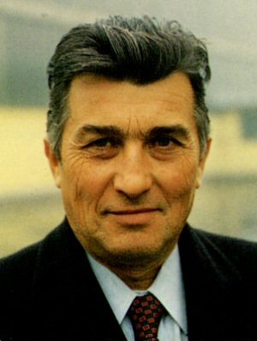
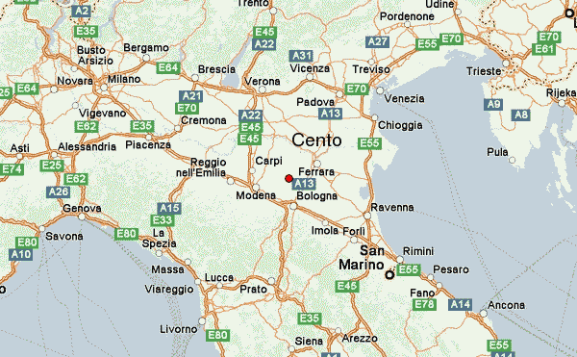
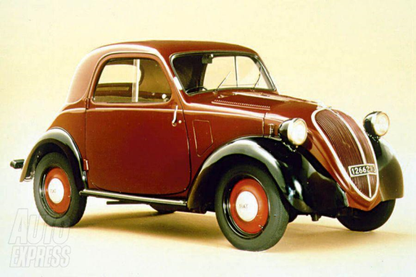
Inventor
Ferruccio Elio Lamborghini
April 28, 1916
Cento Italy
Fiat Topolino
Notes:
Ferruccio Elio Arthur Lamborghini was born on April 28, 1916 under the Zodiac sign of Taurus, his parents were farmers but Ferruccio soon decided he wanted to do something with mechanics. He started working on his father’s tractor out of interest and was able to attend a technical school in Bologna Italy later on. During the Second World War he was enrolled into the Italian Air Force, working for the transport section, after 1944 he became a prisoner of war in the British military forces who put him to work in their motoring department, this way Ferruccio got firsthand experience keeping cars on the road, even with limited part supplies.
After the war he returned to his hometown and started converting old war surplus material into much needed tractors for the local farmers. The Lamborghini tractor business was inaugurated in a small garage, but the business got really successful and had to move into larger premises soon thereafter.
By now Ferruccio also started tuning Fiat cars; he actually built a Fiat Topolino for himself and entered in the 1948 Mille Miglia competition, unfortunately the car was wrecked in an accident. By 1949 Ferruccio Lamborghini was able to start building tractors from scratch, without using any leftovers, the Lamborghini Trattrice factory was founded and production soon grew even further. The Lamborghini tractors became known as the best in Italy and Ferruccio started organizing tractor-pulls in his hometown just to show the superiority of his machines.

Slide 3
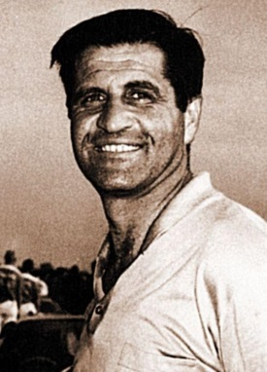
Advancement
Giotto Bizzarini
350 GT
Veneno
Notes:
Giotto Bizzarrini, a former employee of Ferrari was recruited to design and build a V-12 for Lamborghini. The engine was soon completed and produced 400 BHP. Since Ferruccio wanted a GT car and not a race car, the engine was de-tuned to 280 BHP.

Slide 4
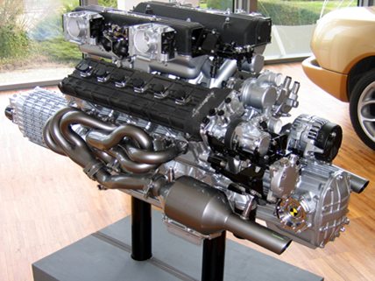
How it works
V12 Engine
Alternator
Notes:
A v12 engine is v shaped engine with 12 cylinders mounted on the crankcase. A v12 automatically in primary and secondary balance, no matter what V angle is used. By using split crankpins any V angle is possible. V12 engines deliver power pulses more often than engines with six or eight cylinders, and the power pulses have triple overlap which eliminates gaps between power pulses and allows for greater smoothness in a luxury car, at the expense of a much greater cost. In a racing car engine, the rotating parts of a v12 can be made much lighter than a v8 with a cross plane crankshaft because there is no need to use heavy counterweights in the crankshaft and less need for the inertial mass. Since cost and fuel economy are usually important even in luxury and racing cars, the v12 has been largely phased out in favor of engines with fewer cylinders. Rolls Royce Merlin v12 powers the hawker hurricane and submarine spitfire fighters that played a vital role in Britain’s victory in the battle of Britain. In automobiles, V12 engines have not been common due to their cost; they are used almost exclusively in expensive sports and luxury cars because of their power. V12 engines were found in many cars including the Cadillac 1931 and the 1936 Rolls Royce. Vehicle’s with 8 to 12 and 16 cylinders provided higher levels of performance compared t those with fewer cylinders. Improvements in combustion chamber design and piston form enabled lighter V8 engines to surpass the V12 in power starting from the 1930s; only the smaller, H-Series Lincoln V-12 remained after WWII and it was replaced by a V8 in 1949. Similarly, as they seemed excessive for the postwar market in Europe, production of V12-engined-cars was very limited until the 1960s.
An automotive charging system is made up of three major components: the battery, the voltage regulator and an alternator. The alternator works with the battery to generate power for the electrical components of a vehicle, like the interior and exterior lights, and the instrument panel. An alternator gets its name from the term alternating current (AC).
Alternators are typically found near the front of the engine and are driven by the crankshaft, which converts the pistons' up-and-down movement into circular movement. (To learn more about the basic parts of car engines, read How Car Engines Work.) Some early model vehicles used a separate drive belt from the crankshaft pulley to the alternator pulley, but most cars today have a serpentine belt, or one belt that drives all components that rely on crankshaft power. Most alternators are mounted using brackets that bolt to a specific point on the engine. One of the brackets is usually a fixed point, while the other is adjustable to tighten the drive belt.

Slide 5
Cultural Impacts
Italians are not to happy with Lamborghini
Notes:
People from Ferruccio’s home town are not so happy with his creations because they are to expensive and almost all the people from bologna can’t afford any of the Lamborghini cars

Slide 6
Purpose
Luxury
Fast
Notes:
The purpose for Lamborghini was to create a fast and luxurious car, and even though they are not as luxurious as a Bentley or a rolls Royce, they are faster than both of them .

Slide 7
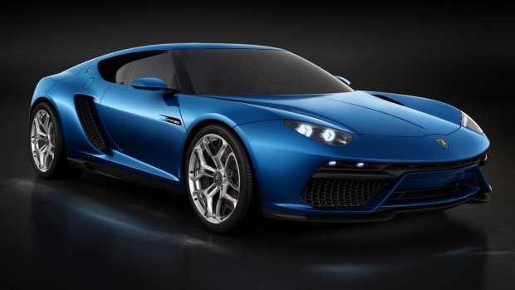
Future
Electric car
Notes:
Lamborghini has a lot of ideas for the future and one of them is to create a fast electronic car

Slide 8
Lamborghini/V12

